Slide 1
Git: The Hard Way
Mark Aligbe | 14/06/18

Slide 2
Who This Is For
Absolute beginners
Those who want to learn how to properly merge
Those who are not comfortable with command line git

Slide 3
How This Is Going to Work
I’ll talk a bit
I’ll show a command window and type some commands
You’ll type the commands too
You’ll earn your degree

Slide 4
Table of Contents
What is Git?
Making a repository (also, what’s a repository?)
Tracking changes
Undoing changes
Experimenting with changes
Merging changes
Sharing changes
Wrapping up: command showcase

Slide 5
Let's Get Started

Slide 6
What is Git?
Git helps you keep track of files
Git helps you keep track of changes to files
It’s fully decentralized
It makes experimenting easy
It helps protect you from yourself and others

Slide 7
Making A Repository
Repository: all the folders and files you want git to track
git init
There’s a new “.git” folder!
git status

Slide 8
Tracking Changes
Git tracks changes, not files
git add
git status (again)

Slide 9
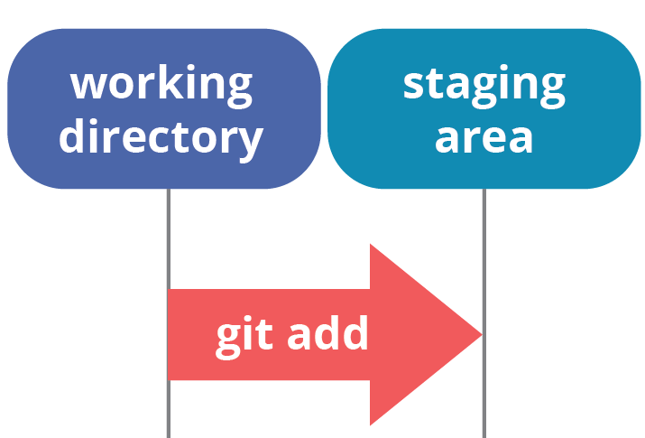
Working Directory vs Staging Area
Working directory: the current state of your files
Staging area: the current set of changes git is tracking
https://www.quora.com/Whats-the-difference-between-committing-and-pushing-in-Git

Slide 10
Tracking Changes: ”Save”
“Saving” the current set of changes is called “committing”
git commit –m
git status (it’s a theme)

Slide 11
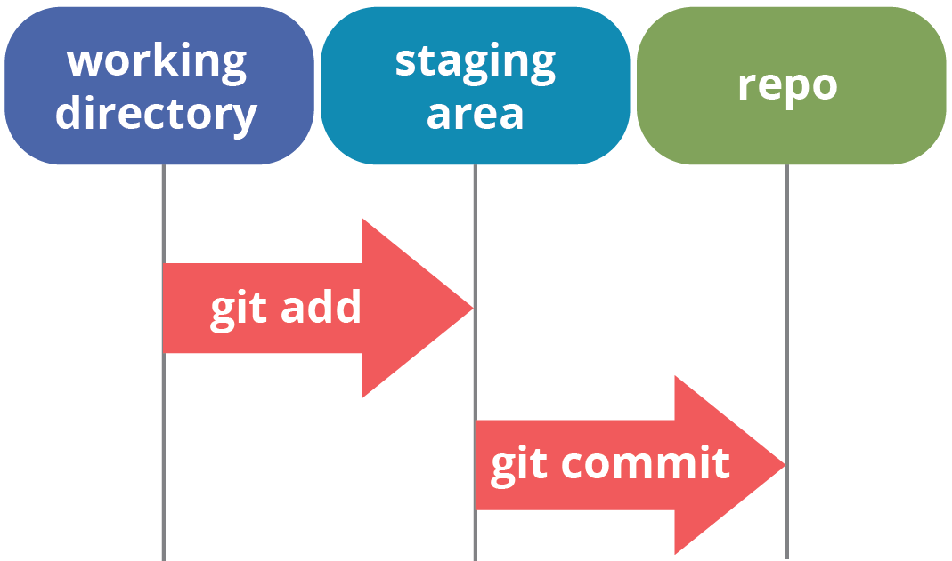
The Repository Emerges
The repository is the collection of all changes
https://www.quora.com/Whats-the-difference-between-committing-and-pushing-in-Git

Slide 12
Inspecting the Repository
git log (press “q” to quit)

Slide 13
I Made a (small) Mistake
Modify the previous commit:
git add
git commit --amend
This commit is fubar, just get rid of it:
git revert (you can also revert reverts!)

Slide 14
Experimenting with Changes

Slide 15
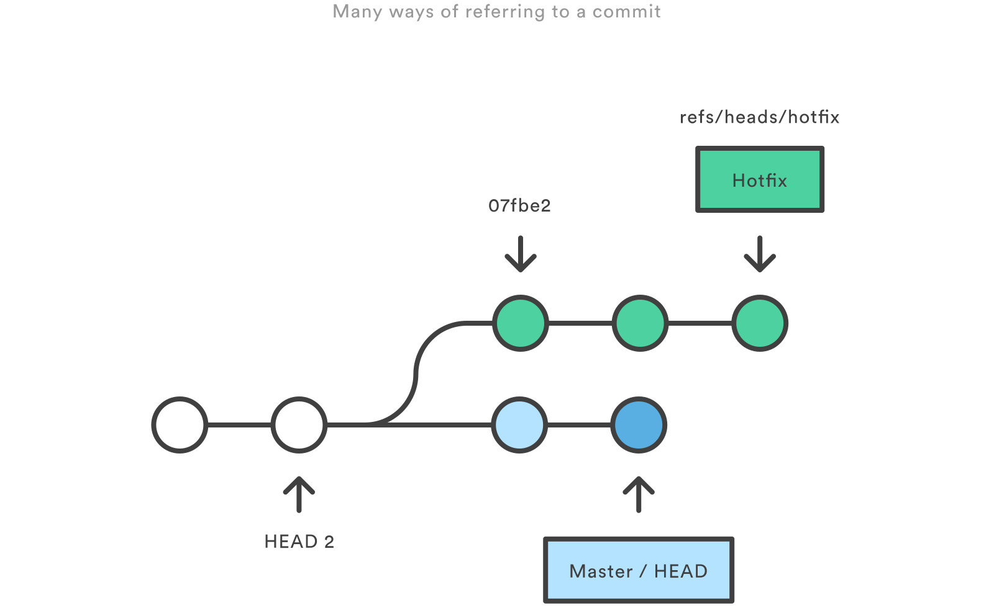
References for 500
References (or refs) are how git refers to commits
Every commit has a unique ID (a hash, or SHA)
A series of commits is a branch
The latest commit in a branch is called the “HEAD”
https://www.atlassian.com/git/tutorials/refs-and-the-reflog

Slide 16
Working with Branches
The default mode of operation
The master branch is the “default” branch
git branch
List all branches: git branch –a
git checkout

Slide 17
Checkout HEADs, Branches, and Commits
git checkout
You can checkout specific commits
Changes here don’t affect any other branch

Slide 18
Branching Paths
git add
git commit -m
git log
git checkout
git add
git commit -m
git log

Slide 19
Merging Changes
The good, , and the ugly

Slide 20
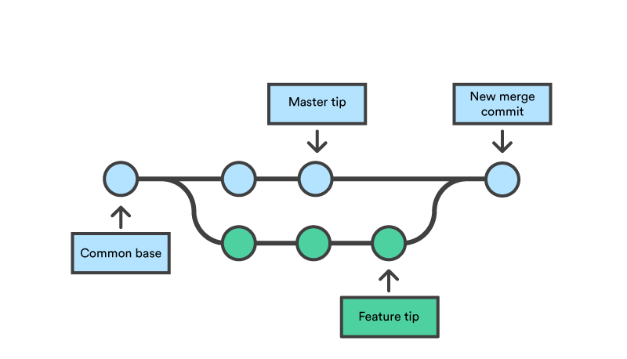
What Is a Merge?
Merging: combining the changes in different refs
Merges can happen automatically, or they can conflict, and need to be resolved manually
https://www.atlassian.com/git/tutorials/using-branches/git-merge

Slide 21
An Easy Merge
git merge

Slide 22
Setting up a Harder Merge
git add –A
git status
git commit –m
git checkout
git commit –a –m
git checkout
git merge

Slide 23
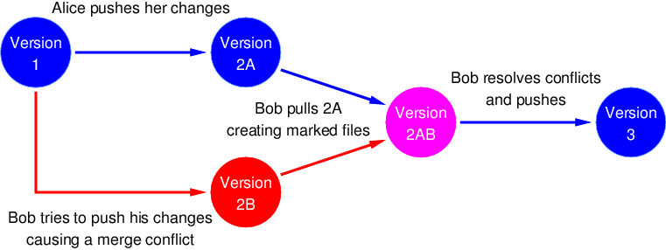
When Stuff Goes Wrong
Git doesn’t know how to automatically resolve the differences
Usually, the same parts of the same file has been modified
http://www.cs.utsa.edu/~cs3443/git/merge-conflicts.html

Slide 24
What’s Theirs Is Ours and What’s Ours Is Theirs
git checkout --theirs
git checkout –-ours
git mergetool

Slide 25
Sharing Changes

Slide 26
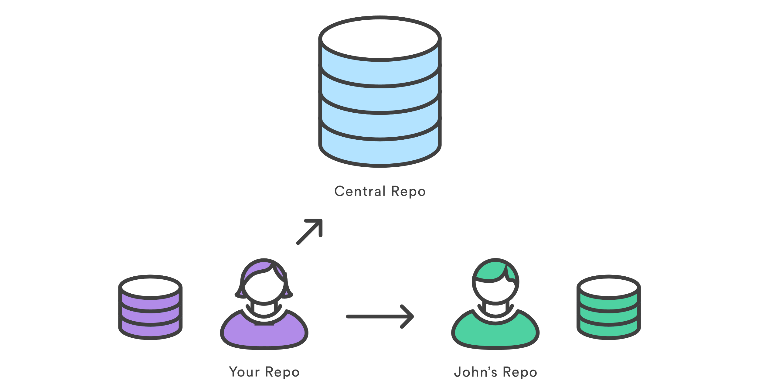
The Remote Repo (It’s Just Another Repo)
It really is just another repository
They enable collaboration
They serve as a backup
They serve as a golden model
https://www.atlassian.com/git/tutorials/syncing

Slide 27
Duplicating a Repository
git init
git remote add origin
git fetch --all
git merge origin/master

Slide 28
There’s an Easier Way
git clone

Slide 29
Sharing Our Commits
git add
git commit –m
git push -u origin master

Slide 30
Retrieving Other’s Commits
git fetch --all
git merge origin/master

Slide 31
There’s Also an Easier Way
git pull

Slide 32
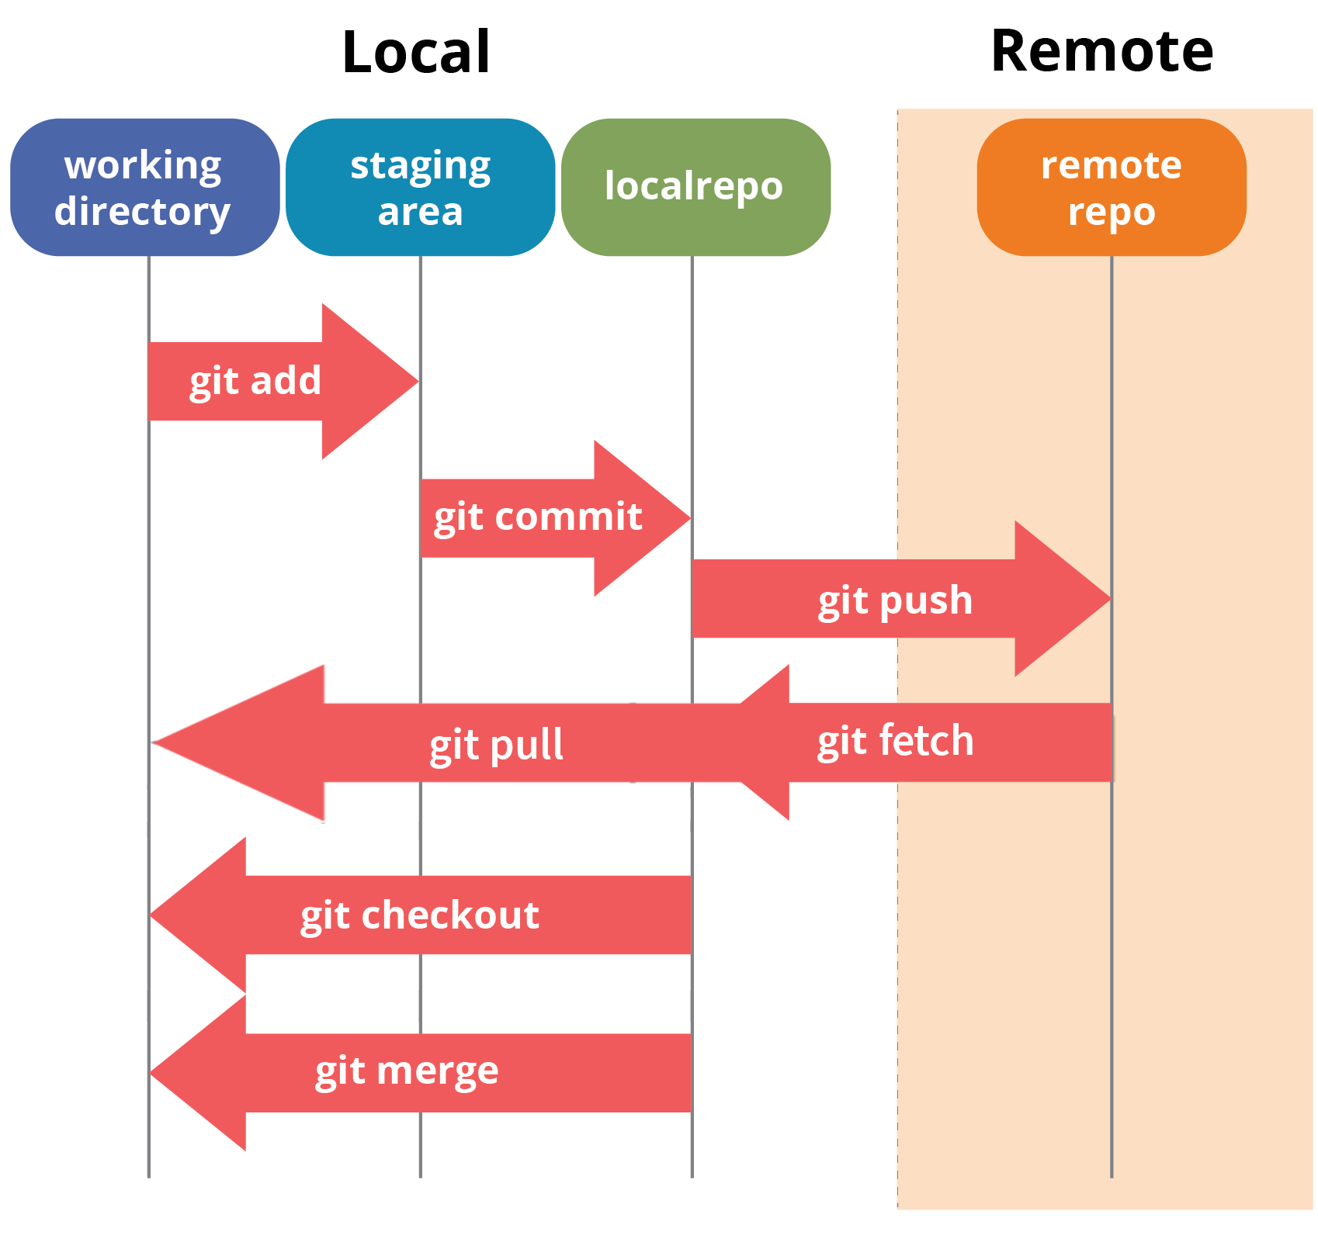
The Full Picture

Slide 33
Fin

Slide 34
Command Showcase

